Slide 1
Iceberg Secret
By Eric Blumenstock
Notes:
Introduce myself
Purpose – Explain what the secret is and how it pertains to us in the field of software engineering
and provide an overview of the surrounding details to give context

Slide 2
What is the secret?
A software analogy by Joel Spolsky describing:
  Customers
  Non-technical Managers
  Software Developers
Onlookers only perceive about 10% of the iceberg – the part above water
Notes:
Now to alleviate everyone’s pressing question of what the iceberg secret is
First and foremost it is an analogy by Joel representing the relationship between customers, non-technical managers, and software developers
You know how an iceberg is 90% underwater? Well, most software is like that too -- there's a pretty user interface that takes about 10% of the work, and then 90% of the programming work is under the covers.

Slide 3
What is the secret? (cont.)
People who are not software developers do not understand the other 90%
User interface as a measurement of project completion
  Angry non-technical managers and customers
Notes:
Remaining time spent is thought of as “software developers twiddling their thumbs” not getting any real work done.
The secret is that people who aren’t programmers do not understand that the UI is not a measurement of how well the project is going.
Angry managers and customers can cause issues, managers may fire who they think is the “slacker” of the group in order to light a fire to the group of engineers

Slide 4
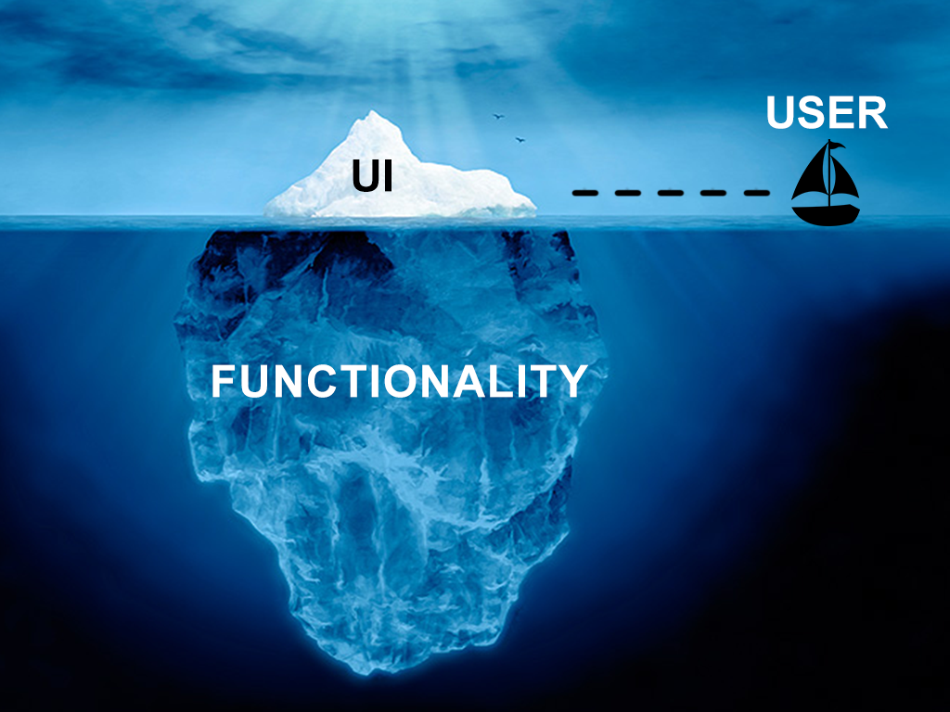
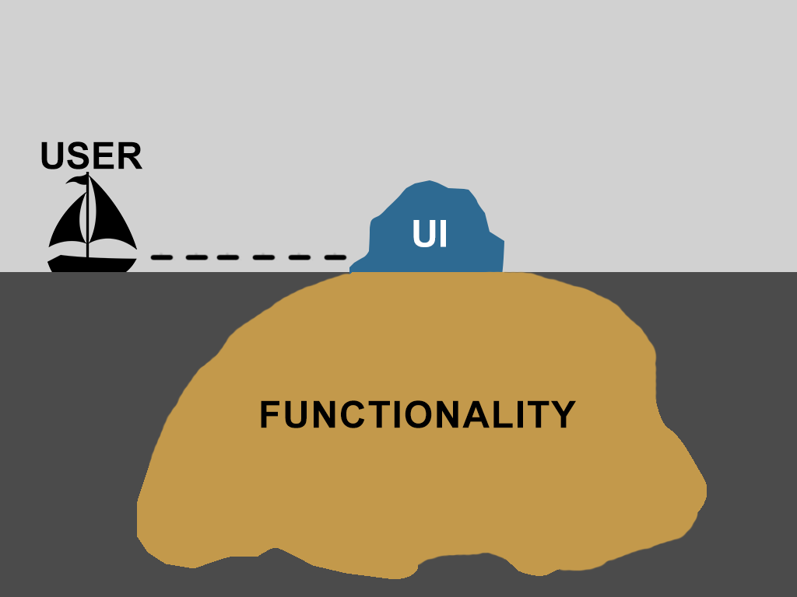
What is the secret? (cont.)
Source: pvisoftware
Notes:
Visual representation of the iceberg secret

Slide 5
Spolsky’s Corollaries
Five corollaries
  Bad UI = Bad Program
  Good UI = Almost done program
  Good UI is better than functionality
  If a manager has to sign off on a project provide several designs
  Beautiful screenshots make good programs
Wrong to us, right for users
Notes:
Ferrari example
All about what the customer perceives
When a customer or manager sees a bad user interface they think “bad program” or poor quality even if the functionality is almost done. Well no that’s not right, we almost have the program done, we’re just waiting on the graphic artist
When a customer or manager sees a very nice looking user interface they think it’s almost done, or “how hard could it be to add the working stuff.”
If a customer is presented with a good UI and no functionality it’s likely that their choice will be the good UI vs the program with a bad ui and all the functionality in the world.
Let managers goof off with the UI and placement of logos and useless stuff.
Customers want to see pretty pixels. "oh, they changed the planet from Jupiter to Saturn. Cool." Never mind what they really did.

Slide 6
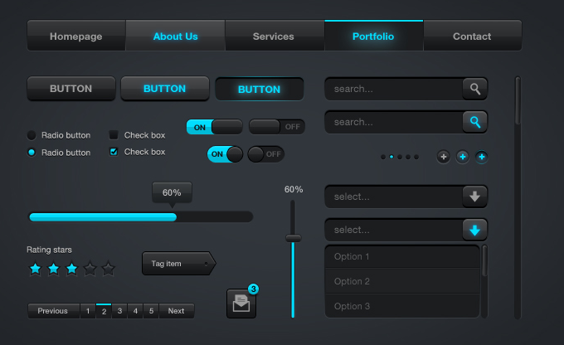
Good UI or Bad UI
Source: Creative Fan
Notes:
So this is the program thus far; looks neat, must be almost done, can’t be too hard to add the “stuff that does stuff”

Slide 7
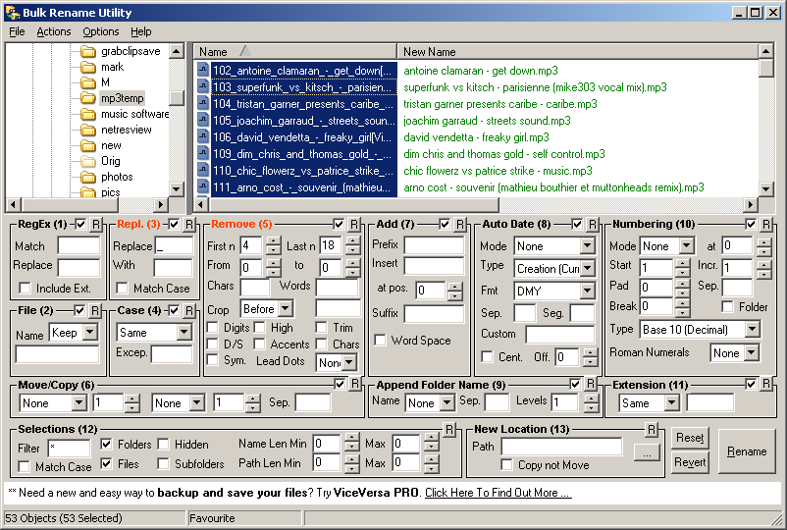
Good UI or Bad UI (cont.)
Source: How To Spot A Psychopath
Notes:
Alright customer, we got everything working, just waiting on the graphics from our artist

Slide 8
Solutions
Detailed schedule
  Updated weekly – Shows work is in progress and is completing on time
When presenting UI make it polished
  Even unfinished parts
  Potentially leave out some features till they’re built
If presenting with data, use “real” data
Notes:
Provide a detailed schedule so people can see that progress is actually being made, and software is on track to being completed in time
Present a UI in a polished fancy manner, potentially leave out some parts so customers and managers can see that features are being built.
Customers that see a fake data set may be an expert in that field, and just simply cannot resist discussing the obviously wrong data, indicating to them that the program is obviously wrong.

Slide 9
Customers Don’t Know
Most common cause of custom projects failing – The Customer
  Changes
  Indecisiveness
Customers don’t know what they want, stop expecting them to know
  The developers have to figure it out
  Research customer domain
Notes:
Customer may have whims, magazine on airplane
YOU have to do the research. YOU have to figure out a design that solves the problem that the customer has in a pleasing way.
Probing questions
Analogy, kitchen design, house design

Slide 10
Customers Don’t Know (cont.)
Two points I disagree with Joel:
Customer in the room
  Depends on the customer
  Probably won’t be the dweeb
  Progress is seen by customer
  Who is buying the software
Customers know what they want
  Steering
Notes:
Joel states you’re crazy if you bring a customer into the room as a member of the team. Extreme programming folks
Imagined and real needs distinguished from steering customer.

Slide 11
References
http://www.joelonsoftware.com/articles/fog0000000356.html
http://discuss.fogcreek.com/joelonsoftware/?cmd=show&ixPost=3676
http://www.pvisoftware.com/blog/wp-content/uploads/2013/11/Pegasus_vertex_Iceberg.png
http://creativefan.com/sleek-web-ui-elements-free-psd-download/
http://www.howtospotapsychopath.com/2009/05/21/a-surprisingly-un-awful-interface/

